Slide 1
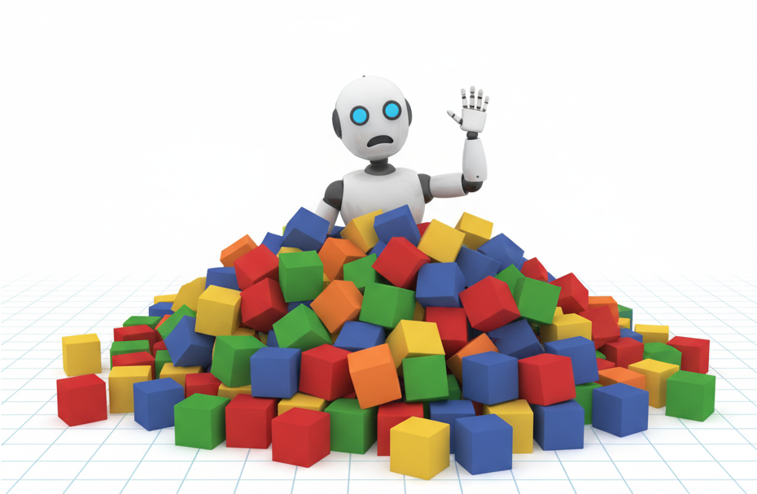
Automating Thought of Search:
A Journey Towards Soundness and Completeness
ICAPS 2026
Daniel Cao* Michael Katz Harsha Kokel Kavitha Srinivas Shirin Sohrabi
Cornell University IBM
*Work performed while at IBM

Slide 2
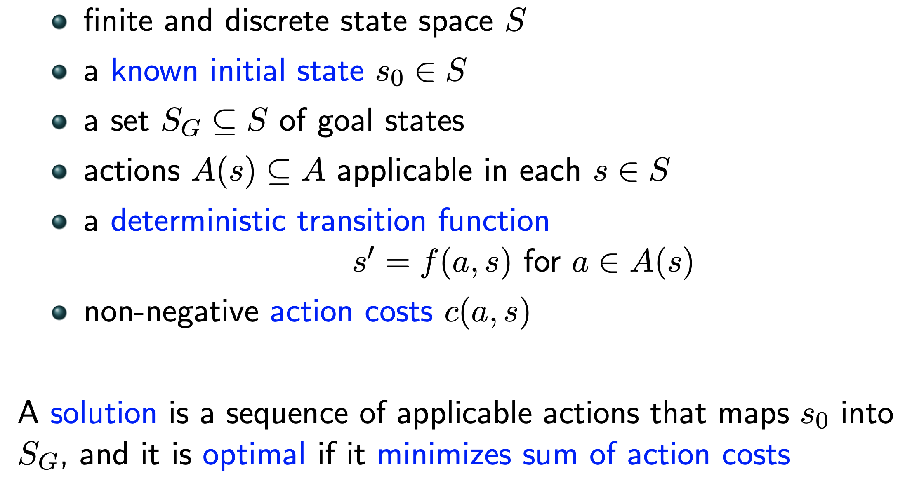
Planning problem
Mathematical Model:

Slide 3
Planning problem
Mathematical Model:
Black Box
goal: S -> {T,F}
succ: S ->2^{SxA}

Slide 4
Planning problem
Mathematical Model:
Planning Language
types
objects
predicates
initial state
actions
goal
preconditions
effects
Black Box
goal: S -> {T,F}
succ: S ->2^{SxA}

Slide 5
Planning problem
The 24 Game is a mathematical card game in which the objective
is to find a way to manipulate four integers so that the end result is 24.
The game is played with a list of four numbers, and the player must use all four numbers exactly once, using any combination of addition, subtraction, multiplication, or division, to arrive at the number 24.
Mathematical Model:
Planning Language
types
objects
predicates
initial state
actions
goal
preconditions
effects
Black Box
goal: S -> {T,F}
succ: S ->2^{SxA}

Slide 6
Planning problem
The 24 Game is a mathematical card game in which the objective
is to find a way to manipulate four integers so that the end result is 24.
The game is played with a list of four numbers, and the player must use all four numbers exactly once, using any combination of addition, subtraction, multiplication, or division, to arrive at the number 24.
Mathematical Model:
Planning Language
types
objects
predicates
initial state
actions
goal
preconditions
effects
Black Box
goal: S -> {T,F}
succ: S ->2^{SxA}

Slide 7
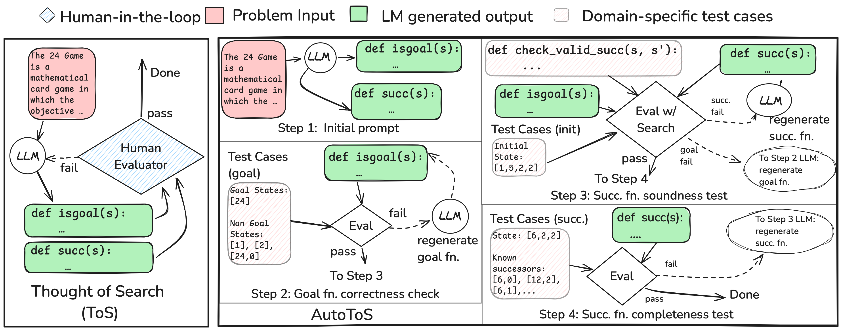
Background: Thought of Search (ToS)
Katz et al, NeurIPS 2024

Slide 8
Background: Thought of Search (ToS)
Katz et al, NeurIPS 2024
Plug the functions into a standard search (BFS/DFS/IDDF…)

Slide 9
Background: Thought of Search (ToS)
Katz et al, NeurIPS 2024
Plug the functions into a standard search (BFS/DFS/IDDF…)
Results?

Slide 10
Background: Thought of Search (ToS)
Katz et al, NeurIPS 2024
Plug the functions into a standard search (BFS/DFS/IDDF…)
Results?
100% accuracy across all tested domains!
Execution time in ms per instance

Slide 11
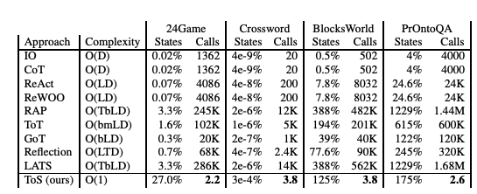
Background: Thought of Search (ToS)
Katz et al, NeurIPS 2024
Plug the functions into a standard search (BFS/DFS/IDDF…)
Results?
100% accuracy across all tested domains!
Execution time in ms per instance

Slide 12
Background: Thought of Search (ToS)
Katz et al, NeurIPS 2024
Plug the functions into a standard search (BFS/DFS/IDDF…)
Results?
100% accuracy across all tested domains!
Execution time in ms per instance
Limitation: need human in the loop!

Slide 13

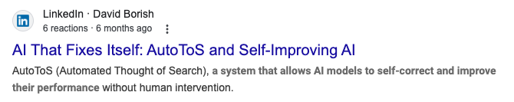


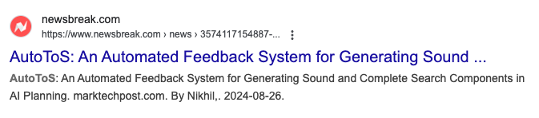
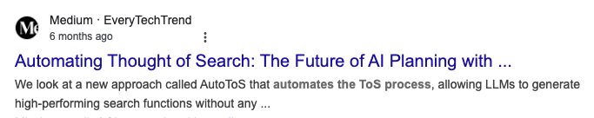

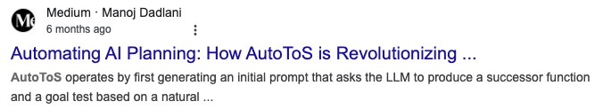
Automating Thought of Search (AutoToS)
Cao et al, ICAPS 2026

Slide 14
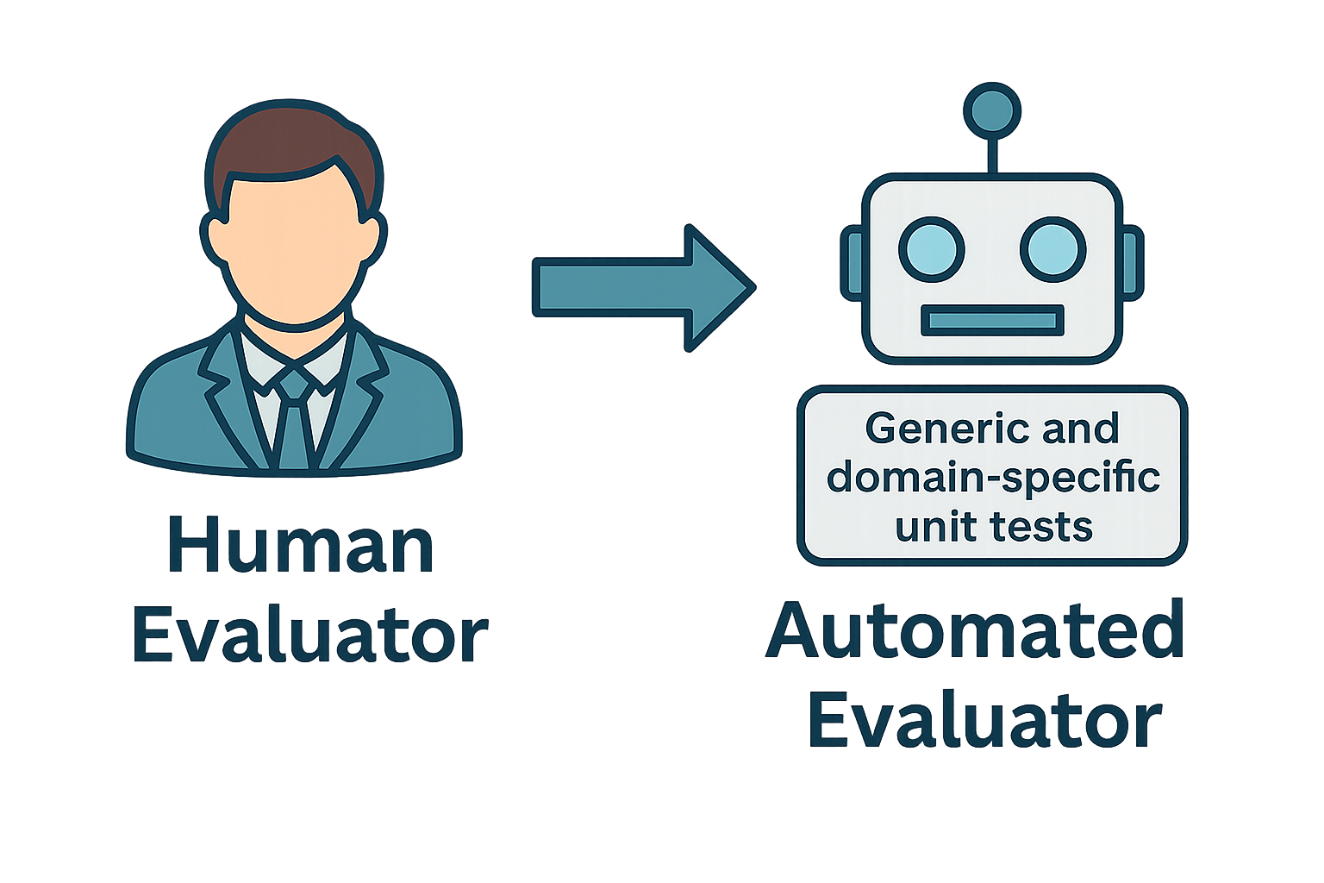
AutoToS: Core Idea

Slide 15
How does it work?

Slide 16
How does it work?

Slide 17
How does it work?

Slide 18
How does it work?

Slide 19
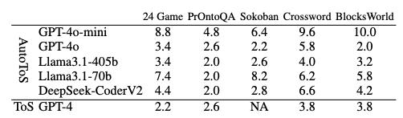
Is it much worse than a human feedback?

Slide 20
Does it match the accuracy of ToS?

Slide 21
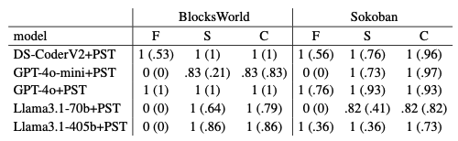
Does it match the accuracy of ToS?

Slide 22


